Slide 1

Financial inclusion in Africa
Kenya, Rwanda, Uganda and Tanzania

Slide 2
Table of content
Introduction
Table of content
Source of Dataset
Problem Description
Methodology
Visualization
Objective
Conclusion

Slide 3
Source
zindi

Slide 4

Brief History Of Banking in Africa
Founded in 1894 as The Bank for British West Africa, FBN Group's First Bank was the very first banking institution to be established on the African continent.

Slide 5
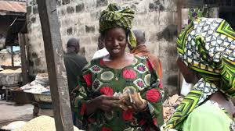

Slide 6
Financial Inclusion remains one of the main obstacles to economic and human development in Africa. For example, across Kenya, Rwanda, Tanzania, and Uganda only 9.1 million adults (or 13.9% of the adult population) have access to or use a commercial bank account.

Slide 7
Problem Description
1
Price sensitivity
2
Lower confidence and understanding
3
Low levels of trust

Slide 8
Sourcing of data
Methodology
Importing of Data
Cleaning of Data
Categorizing of Data
Data visualization
Analyzing of data
Training and testing

Slide 9
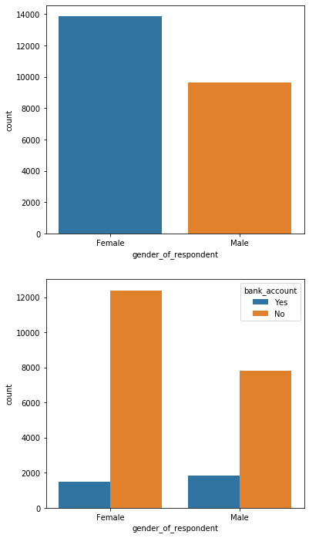

Slide 10
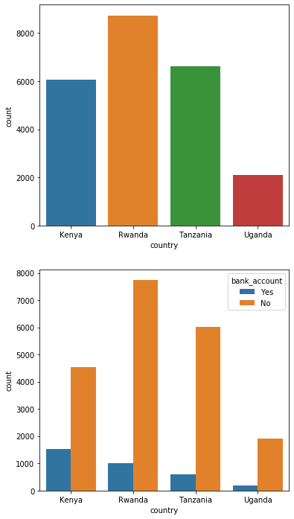

Slide 11
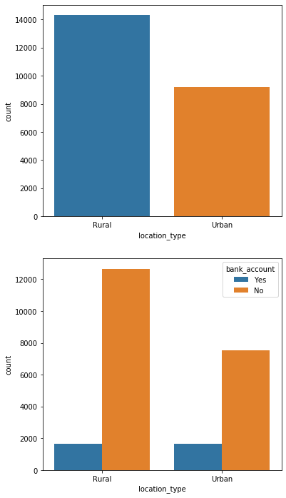

Slide 12
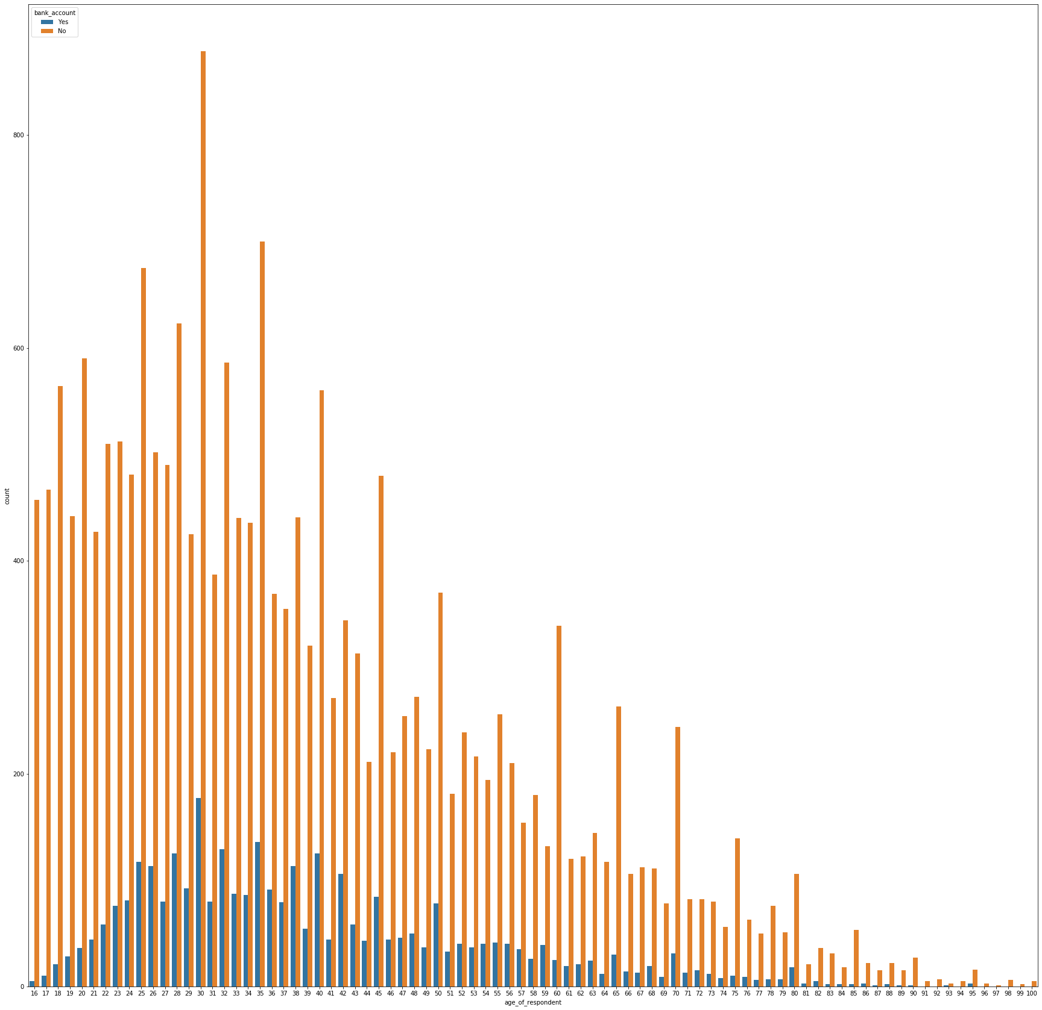

Slide 13
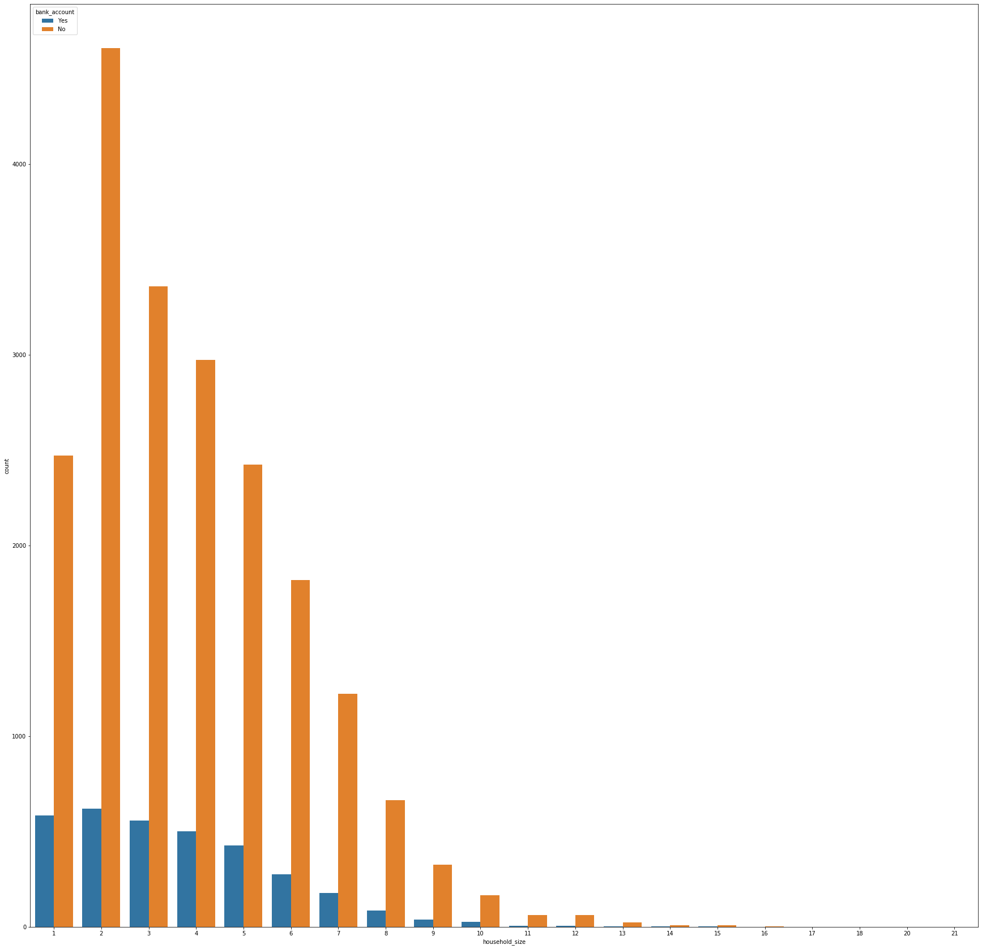

Slide 14
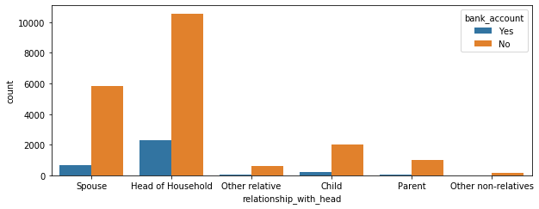

Slide 15
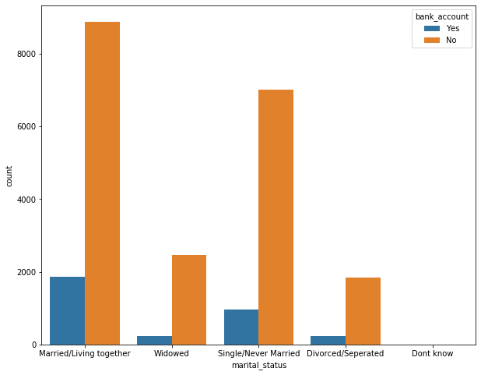

Slide 16
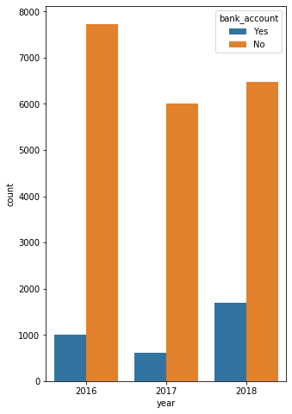

Slide 17
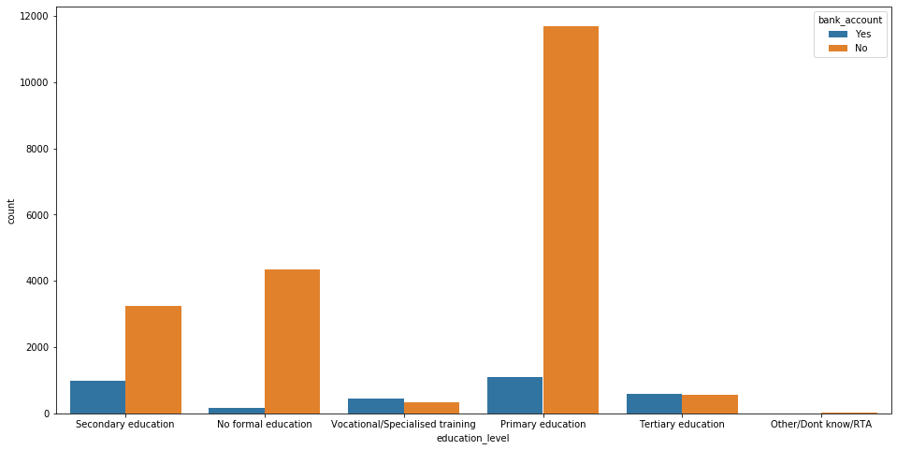

Slide 18
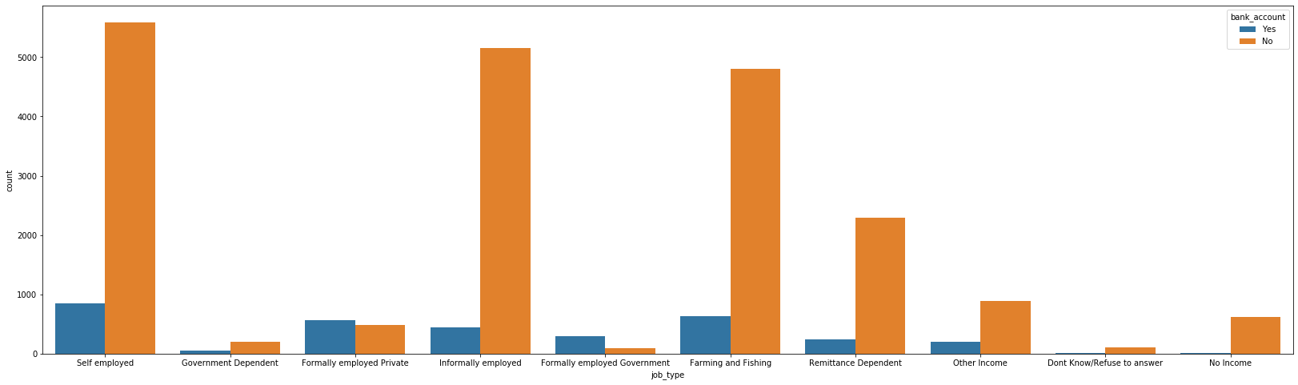

Slide 19
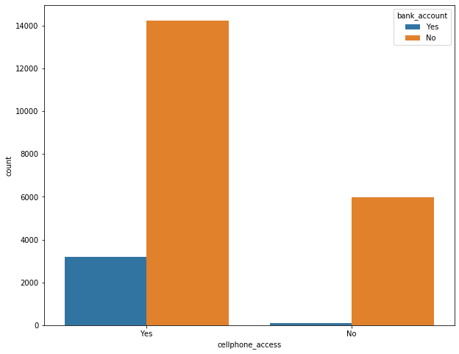

Slide 20
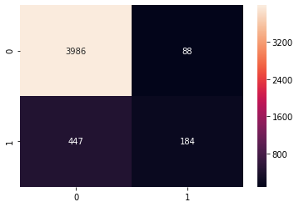

Slide 21
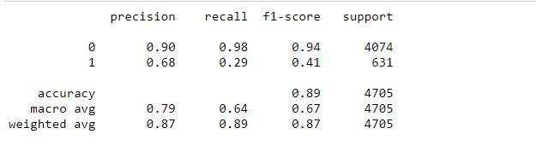

Slide 22
Conclusion
Access to bank accounts enable households to save and facilitate payments while also helping businesses build up their credit-worthiness and improve their access to other finance services. Therefore, access to bank accounts is an essential contributor to long-term economic growth.

